Slide 1
Microsoft Power BI

Slide 2
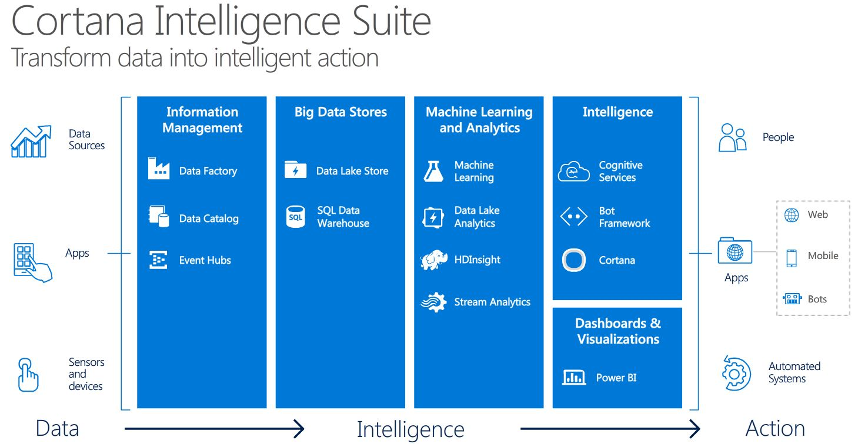
Microsoft Cortana Intelligence Suite
Microsoft Power BI is part of Microsoft Cortana Intelligence Suite which is Microsoft’s answer to Business Intelligence challenges

Slide 3
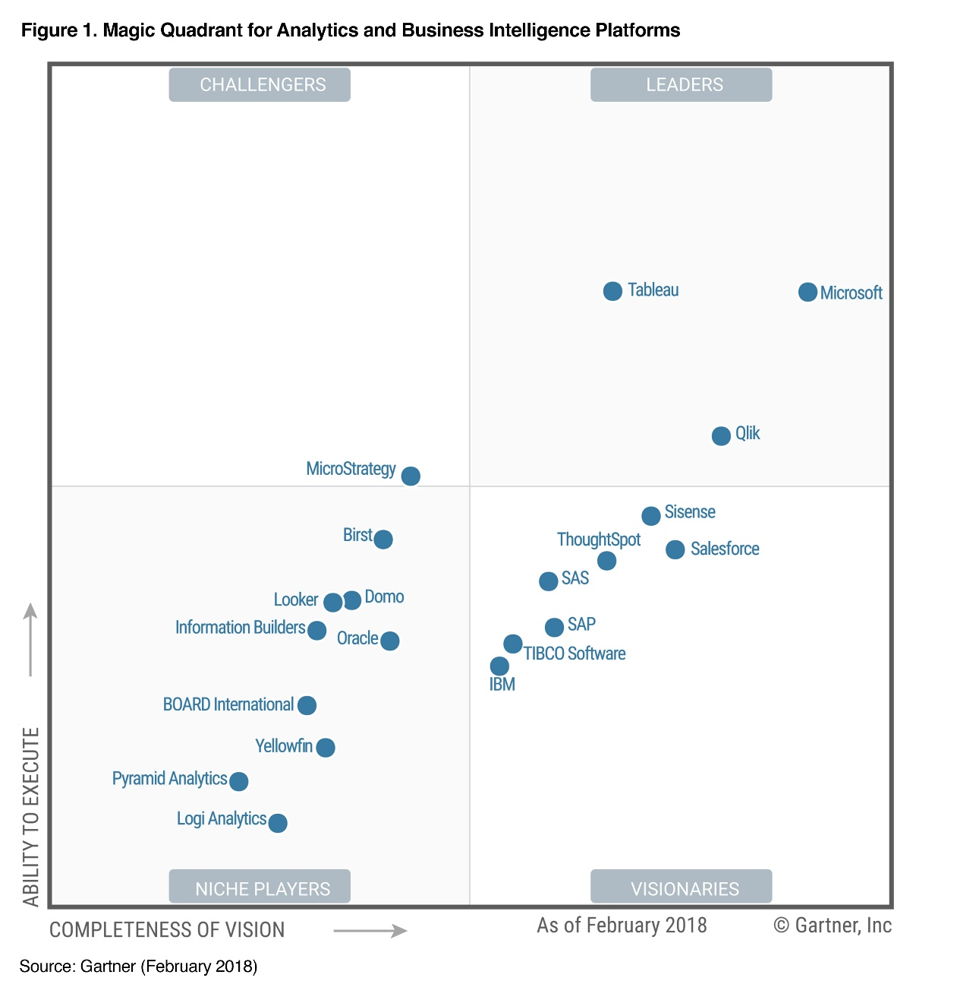
Gartner Analytics and Business Intelligence
The Gartner ranks Microsoft as the top leader for Analytics and Business Intelligence Platforms, with a better completeness of vision than Tableau
See the Magic Quadrant on the right. Source : Gartner (February 2018)

Slide 4
Power BI portfolio
Power BI Desktop
Power BI Free
Power BI Pro
Power BI Premium
Licensed by
user
Licensed by
user
Licensed by
user
Licensed by capacity
Free report authoring and ad-hoc data exploration
Quick, easy-to-use self-service analytics for personal use
Quick, easy-to-use self-service analytics for users requiring collaboration, dashboard sharing, ad hoc analysis, and report publishing
An add-on to Power BI Pro for projects requiring large scale data, demanding performance, and the ability to distribute content without requiring per user licensing

Slide 5
Power BI Products

Slide 6
Power BI user license tiers
Free
Pro ($10/user/month)
Connect to 70+ data sources
Publish to web
Peer-to-peer sharing
Enterprise distribution
Apps
Email subscriptions
Embed APIs and controls
Collaboration
Group workspaces
Analyze in Excel, analyze in Power BI Desktop

Slide 7
Power BI capacity tiers
Pro (shared, $10/u/m)
Premium (dedicated, $5k/m)
Total storage size
10 GB
100 TB
Refresh rate
8/day
48/day
Isolation with dedicated hardware
¹
Enterprise distribution to Free users
Apps
²
Email subscriptions
³
Embed APIs and controls
³
Performance
Pin to memory
Incremental/dedicated refresh
Read-only replicas
Geo distribution
Power BI reports on-premises
¹ EM3 SKU or higher.
² Basic user consumption in apps includes viewing content in web and mobile; using Q&A, Quick Insights, and Cortana; and exporting to Excel, CSV, and PowerPoint.
³ Embedded SKUs only allow consumption through embedded APIs and controls, NOT apps or email subscriptions.

Slide 8
Collaboration vs. consumption
Pro
Self-service and collaboration—licensed per user
Premium without Pro
Basic consumption— not licensed per user
Total storage size
10 GB
100 TB
Refresh rate
8/day
48/day
Isolation with dedicated hardware
¹
Enterprise distribution
Apps
Create and consume
Consume only²
Collaboration
Edit and save customized views
^{3, 4}
Create personal dashboards (pin to new dashboards)
³
Connect and analyze data in Excel or Power BI Desktop
³
Share and collaborate with Office 365 Groups and Microsoft Teams
³
¹ EM3 SKU or higher.
² Basic user consumption in apps includes viewing content in web and mobile; using Q&A, Quick Insights, and Cortana; and exporting to Excel, CSV, and PowerPoint.
³ Collaboration capabilities can be enabled with a Power BI Pro license per user.

Slide 9
Power BI Premium capacity
CAPACITY NODE | VIRTUAL CORES | BACKEND CORES | FRONTEND CORES
Power Bl Premium EM1 ¹ | 1 | 0.5 core, 3 GB RAM | 0.5
Power Bl Premium EM2 ¹ | 2 | 1 core, 5 GB RAM | 1
Power Bl Premium EM3 | 4 | 2 cores, 10 GB RAM | 2
Power Bl Premium P1 | 8 | 4 cores, 25 GB RAM | 4
Power Bl Premium P2 | 16 | 8 cores, 50 GB RAM | 8
Power Bl Premium P3 | 32 | 16 cores, 100 GB RAM | 16
1. Backend cores are shared

Slide 10


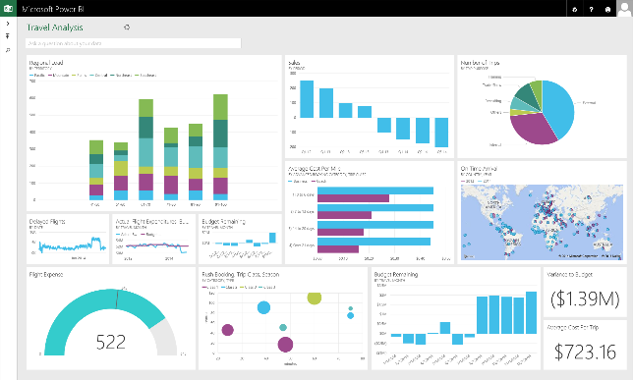

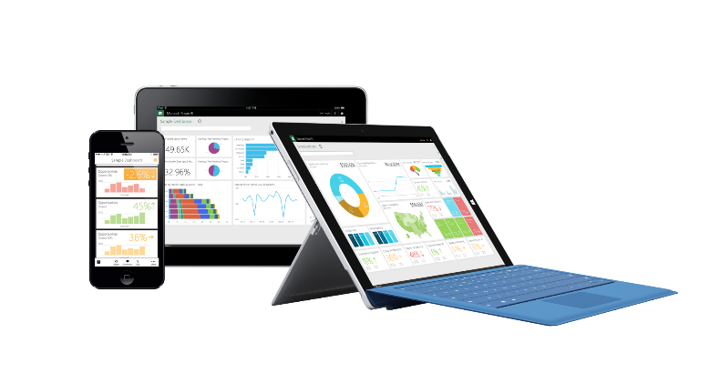
Power BI overview
Business analyst tools
Microsoft cloud
Web browser
HTML
Power BI
Power BI Desktop
Azure data services
Office 365
Non Microsoft cloud software systems
(e.g., SaaS applications, IOT scenarios, and data streams)
SQL Server analysis services
iOS
Databases and other data sources
Dynamics
Partner apps
On-premises data
Microsoft cloud
Non-Microsoft cloud
Mobile apps
Notes:
Power BI is a cloud based business analytics service for pulling together live views across all your data. Connecting to data that resides on premises in SQL Server Analysis Services, data from Microsoft Cloud properties like Dynamics and Office 365 or from Azure data services like SQL DB, Azure Stream Analytics or from a partner solution hosted on Azure.

Slide 11
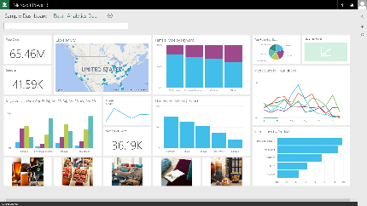
Connect live to your on-premises data
Live Query & Scheduled Data Refresh
Live Power BI reports & dashboards
Deploy quickly with a hybrid BI solution
Manage and secure data on-premises with SQL Server Analysis Services
Optimized query performance for interactive data exploration
Scheduled refresh from on-premises data sources
Live Query
Scheduled Refresh
Cloud
On-premises
SQL Server Analysis Services
Data Source
Notes:
Connect live to on-premises Analysis Services models
Realize the benefits of a cloud based BI solution without having to move your data. With the new Power BI connector for Analysis Services you can create a secure connection to SQL Server Analysis Services from Power BI. When users view and explore dashboards and reports the system will interactively query the on-premises cube to fetch the data using the user’s credentials. With this hybrid solution, you can continue to manage and secure your data on-premises, removing the need to have data reside in the cloud.
Server Analysis Service connector?
Power BI customers can no FAQ:
How does security work with the new SQL w benefit from the role level security in SQL Server Analysis Services. The Power BI user name is passed through to on-premises Analysis Services and appropriate role-based security. Analysis Services resolves the user name to an authorized user via Azure Active Directory (more info:: http://support.powerbi.com/knowledgebase/articles/505323-why-you-need-dirsync-to-connect-to-on-premises-ana) and then applies appropriate role-based security to restricted access.
How does data transfer work between Power BI and SQL Server Analysis Services?
Data is transferred between on-premises Analysis Services and Power BI through the Service Bus (which uses a secure SSL channel).
Does the Power BI connector for Analysis Services add security risk by opening a port on the firewall?
Service Bus (which is the underlying transport/relay service used in this scenario) only uses an outbound port -- it does not require an inbound port to be opened on the on-premises firewall. It uses a shared secret mechanism to create a secure channel between cloud and on-prem.
Will the SQL Server Analysis Service connector work in IaaS as well?
Yes, as long as the IaaS VM is domain-joined and Azure Active Directory DirSync is set up.

Slide 12
On-premises data gateway for Power BI
Power BI
Cloud services
Gateway Cloud Service Data source connection credentials are encrypted
Read access, scheduled refresh, live connection
Azure Service Bus
Application Gateway
Data source connection credentials can only be decrypted by the gateway
On-premises data sources
SQL Server
SQL Server Analysis Services
Other data sources
Files, SharePoint

Slide 13

Understanding Analysis Services with Power BI
Cloud visualization tools
Cloud data sources
Azure Analysis Services
SQL Database
Other data sources
Power BI
Direct Query
SQL Data Warehouse
Cached Model
Power BI Premium
Gateway
On-premises data sources
Authoring and development tools
On-premises visualization tools
SQL Server
Other data sources
Visual Studio
Excel
Direct Query
Analytics Platform System
Teradata
Oracle
Cached Model
Power BI Desktop
Third party BI tools
Notes:
This is a high-level architecture view.
Analysis Services is now part of the cloud solution. If your data sources are all in the cloud such as Azure SQL DW and SQL Database, no on-premises infrastructure is required. Client such as Power BI Desktop, Excel, and 3rd party tools connect directly to the cloud. For Azure Analysis Services to access on-premises data sources, the On-premises data gateway is required. One per Analysis Services server is required to support the volume and performance requirements of the Azure Analysis Services workload.

